Slide 1



A Novel Estimate for the Respondent-Driven Sampling and Network Sampling Methods: A Resampling Approach
Hui Yi, Kyle Vincent, David Okech, Jody Clay-Warner, Nnenne Onyioha-Clayton, Anne Waswas
Center on Human Trafficking Research & Outreach (CenHTRO)
School of Social Work
University of Georgia
August 5, 2024
* Presenting author

Slide 2
Bio
Dr. Hui Yi*, Assistant Research Scientist and Data Scientist – huiyi@uga.edu
Dr. Kyle Vincent, Senior Statistical Consultant - kyle.shane.vincent@gmail.com
Dr. Jody Clay-Warner, Meigs Professor of Sociology, jclayw@uga.edu
Dr. David Okech, Georgia Athletics Association Endower Professor of Human Trafficking Implementation Research, Director of CenHTRO, Director of Prevalence Reduction Innovation Forum (PRIF) – dokech@uga.edu
Nnenne Onyioha-Clayton, Program Manager for Senegal Program – no.clayton@uga.edu
Dr. Anne Waswa, Monitoring, Evaluation, and Learning Coordinator – anne.waswa@uga.edu
Notes:
Dr. Hui Yi, an Assistant Research Scientist and Data Scientist at the University of Georgia School of Social Work at the Center on Human Trafficking Research & Outreach (CenHTRO). I am a survey methodologist who has designed surveys targeting the hidden and hard-to-reach population of human trafficking and has collected over 12,500 survey data from 13 districts in five African countries. I perform large-scale prevalence estimation of various forms of labor and sex exploitation using traditional survey methods and advanced statistical methods.
Dr. Pedro Maues De Avila Goulart, is a Data Analyst at the Center for Human Trafficking Research and Outreach at University of Georgia School of Social Work. With a background in political science, Dr. Goulart applies statistical methods to the study of human trafficking, most notably estimating its prevalence in hotspot areas in Africa.
Dr. Anne Nyarotso Waswa is the Monitoring, Evaluation, and Learning Coordinator at the Center on Human Trafficking Research and Outreach (CenHTRO) in the School of Social Work at the University of Georgia. She is committed to leveraging monitoring, evaluation, and learning methodologies to attain meaningful outcomes and foster sustainable change, driven by her passion for enhancing organizational effectiveness, efficiency and continuous improvement.
Dr. Kyle Vincent is an independent consultant based in Ottawa, Canada.
Dr. Lydia Aletraris is the Associate Director and Prevalence Reduction Innovation Forum (PRIF) Project Coordinator at the University of Georgia School of Social Work, Center on Human Trafficking Research and Outreach. The PRIF forum enlists scholars from universities around the world, such as Brazil, Morocco and Pakistan, to test the efficacy of various methodological approaches in measuring human trafficking prevalence.
Dr. David Okech is Georgia Athletics Association Endowed Professor of Human Trafficking Implementation Research and Director of the Center on Human Trafficking Research & Outreach in the School of Social Work at the University of Georgia. Dr. Okech’s current interdisciplinary and international research aims to create evidence-informed policies and programs for survivors of human trafficking across the globe.
Nnenne Onyioha Clayton, MS, Program Manager for CenHTRO Senegal program. She coordinates a research partnership that led to the first systematic research on sex trafficking among women and girls aged 15-30 in the Kédougou gold mining region of Senegal.

Slide 3





About CenHTRO
CenHTRO Reports
What: Center on Human Trafficking Research and Outreach
Where: School of Social Work, University of Georgia
When: Founded in 2021
Who: Founded by Dr. David Okech (Professor, School of Social Work, Director, CenHTRO and PRIF)
Prevalence reduction innovation forum (PRIF)
This research was funded by a grant from the United States Department of State SSJTIP18CA0015. The opinions, findings and conclusions stated herein are those of the author[s] and do not necessarily reflect those of the United States Department of State.
Notes:
Founded around 2019 by Dr. David Okech (Professor, School of Social Work, Director of CenHTRO) at the University of Georgia
Since founding, we completed 4 large-scale, baseline human trafficking prevalence studies in West Africa, including 2 studies in Sierra Leone, 1 in Guinea, and 1 in Senegal.
We developed the Prevalence Reduction Innovation Forum (or PRIF) which involved partnerships with researchers to test prevalence estimation methods for human trafficking in 6 countries and 7 studies.
Currently we are researching labor trafficking among youth and young adults in the Southern African region, especially Malawi and Zambia.

Slide 4
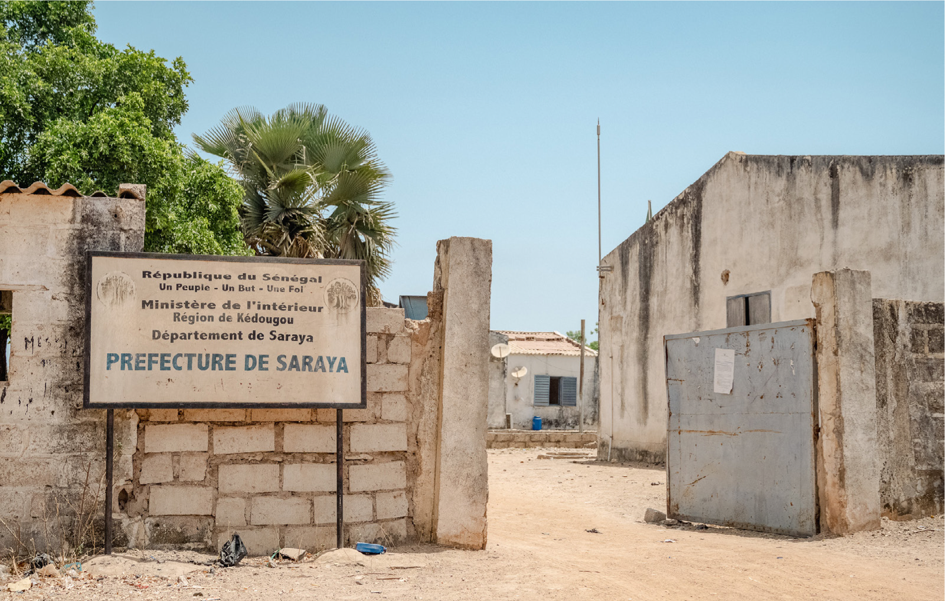


Introduction
Sex trafficking in Kédougou is believed to be both internal and transnational, with victims coming from within Senegal as well as from the neighboring countries of Ghana, Nigeria, Guinea, Mali, and Burkina Faso (Office to Monitor and Combat Trafficking in Persons, 2020).
However, evidence to date has been largely anecdotal, limiting efforts to understand the problem’s true scale and nature.
The Center on Human Trafficking Research & Outreach is an international consortium of anti-slavery researchers and policy advocates from the University of Georgia (UGA) who seek to reduce the prevalence of human trafficking in Sub-Saharan Africa.
Notes:
The U.S. Department of State (DoS) 2020 Trafficking in Persons (TIP) Report for Senegal, as well as non-governmental organizations (NGOs) and international organizations, have revealed evidence of sex trafficking in the Southeastern gold mining region of Kédougou (Office to Monitor and Combat Trafficking in Persons, 2020).
Sex trafficking in Kédougou is believed to be both internal and transnational, with victims coming from within Senegal as well as from the neighboring countries of Ghana, Nigeria, Guinea, Mali, and Burkina Faso (Office to Monitor and Combat Trafficking in Persons, 2020).
However, evidence to date has been largely anecdotal, limiting efforts to understand the problem’s true scale and nature.
To this end, Center on human trafficking research & outreach (or CenHTRO) contracted Mantle to conduct research to estimate the prevalence of sex trafficking among women ages 18-30 who are engaged in commercial sex in Senegal’s Kédougou gold mining region at baseline (2021) and endline (2024) and to evaluate changes over time resulting from grantee work to address service and policy gaps in prevention, prosecution, and protection.

Slide 5
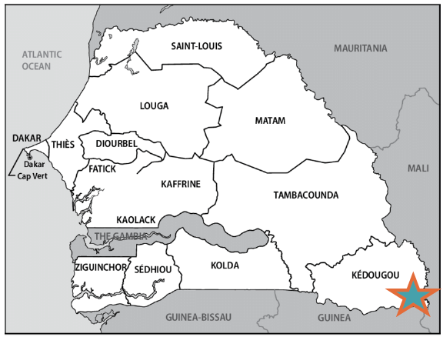
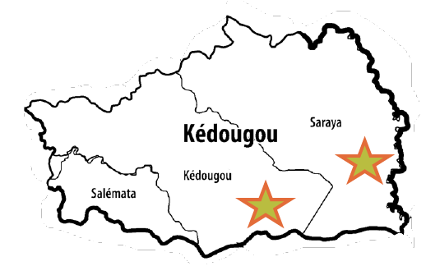
Kédougou Gold Mining Areas in Senegal
Notes:
According to a 2019 study by the Artisanal Gold Council (2019), there are 97 artisanal gold mine sites in the Kédougou region, most of which are in the Saraya department, with the remaining located in the Kédougou department. An estimated 25,119 people work to produce approximately 3 tonnes of gold per year in these mining sites.
Saraya and Kédougou gold mining areas have a number of characteristics that promote exploitative practices towards women, particularly sex trafficking. Mining towns in this region were described as hyper-masculine, with large populations of young male workers and social norms and beliefs that promote and condone abuse of women.
Mission: Measure and reduce sex trafficking prevalence within artisanal gold mining sites of the Kédougou region and address service and policy gaps in prevention, prosecution, protection and partnership.

Slide 6
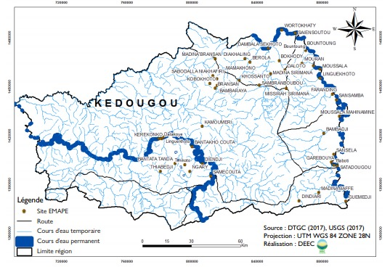
Research Objective
The main objective of the research:
Establish a methodologically rigorous baseline prevalence estimate of sex trafficking among women engaged in commercial sex in Saraya and Kédougou departments in Senegal.
Base population: is defined as women aged 18-30 engaging in commercial sex and living in mining communities in Kédougou region at the time of the baseline survey.
Target population: is female severe sex trafficking victims aged 18-30 living in mining communities in Kédougou region, i.e., in Kédougou and Saraya departments.
Map of artisanal and small-scale mining sites in Kédougou region.
Notes:
The main objective of the research is to establish a methodologically rigorous baseline prevalence estimate of sex trafficking in Saraya and Kédougou departments that can serve as a benchmark for evaluating the extent to which anti-slavery programs and policies have effectively reduced prevalence among women aged 18-30 years.
Secondarily, the research will assess the perceived service and policy gaps to inform intervention programs.
In order to estimate prevalence (i.e., the proportion of a base population experiencing a condition at a given time and location), it is necessary to define the base population and the target population.

Slide 7
Definition of Sex Trafficking
Definition of Severe Forms of Sex Trafficking | Relevant Questions in the Quantitative Survey Questionnaire
The 2000 Trafficking Victims Protection Act (TVPA) Definition: Section (8) The term ‘severe forms of trafficking in persons’ means: Sex trafficking in which a commercial sex act is induced by force, fraud, or coercion or in which the person induced to perform such act has not attained 18 years of age. | The following items from the “Recruitment into Sex Trafficking” section, ever and in the past 12-month.
 | Any item from the “Employment Practices and Debt” section, ever and in the past 12-month.
 | Any item from the “Coercion and Control” section, ever and in the past 12-month.
 | Any item from the “Freedom of Movement” section, ever and in the past 12-month.
Notes:
In order to estimate prevalence (i.e., the proportion of a base population experiencing a condition at a given time and location), it is necessary to define the base population and the target population.
Base population: In the context of this study, the base population is defined as women aged 18-30 engaging in commercial sex and living in mining communities in Kédougou region at the time of the baseline survey.
Target population: The target population is female severe sex trafficking victims aged 18-30 living in mining communities in Kédougou region, i.e., in Kédougou and Saraya departments.
Definition of individuals engaged in commercial sex: Individuals engaged in commercial sex are defined as per the commercial sex act, i.e., those who engage in “any sex act on account of which anything of value is given to or received by any person” (as referenced in the DoS Terms and Definitions, pg. 22: TVPA, section 103, amended as 22 U.S.C. 7102). For this study, a woman engaged in commercial sex is defined as someone who has exchanged vaginal or anal sex for money or goods in the past 12 months.
Severe sex trafficking victims: The study focuses on females who are currently victims of severe sex trafficking, according to the definition in TVPA, section 103(9).

Slide 8
RDS Method
RDS is a type of chain referral sampling method to reach hidden populations
Begins with a set of ‘seeds’
Seeds recruit peers, who recruit peers, etc. in “waves”
Recruits are linked by coupons with unique identifying numbers
Recruitment is limited through reducing the number of coupons to send
Incentives provided for completed survey and possibly for each successful recruit (aka “dual-incentive procedure”)
Traditional RDS aims for very long recruitment chains
Notes:
RDS-based estimation requires several assumptions in order for valid procedures to be used. For example, 1) the population must be comprised of a single network (that is, there is a sample path between any two individuals in the study population); 2) respondents recruit individuals from their personal network completely at random; and 3) respondents can accurately report their personal network size, which is often used in RDS weighting schemes (Volz and Heckathorn 2008); for further information, see Heckathorn and Cameron (2017) for a general overview of typical RDS data collection and estimation procedures.
For most estimators, RDS is heavily assumption driven:
First order Markov Process (i.e., sampling occurs with replacement, sample becomes independent from the seeds)
Respondents know one another as members of the target population (and these are reciprocal)
Respondents are linked by a network composed of a single component
Respondents can accurately report their personal network size (degree)
Peer recruitment is a random selection from the recruiter’s network
Each respondent recruits two peers

Slide 9
RDS Assumptions
For most estimators, RDS is heavily assumption driven:
    First order Markov Process (i.e., sampling occurs with replacement, sample becomes independent from the seeds)
    Respondents know one another as members of the target population (and these are reciprocal)
    Respondents are linked by a network composed of a single component
    Respondents can accurately report their personal network size (degree)
    Peer recruitment is a random selection from the recruiter’s network
Notes:
The biggest challenge for RDS is to verify the estimation assumptions.
3. RDS assumes that respondents are connected through a single network.

Slide 10
Why is RDS well suited for sampling hard-to-reach populations?
Requires no sampling frame, but instead access to a set of “seeds”
Allows participants to remain anonymous
People recruit their peers (mitigates stigma, discrimination and lack of trust)
When implemented correctly, can provide representative estimates and confidence intervals for population quantities
Free computer software available (RDS Analyst, RDS package in R)
Notes:
Respondent-Driven Sampling Design
RDS, as originally presented in Heckathorn (1997), is a peer-referral-based strategy that typically commences with the selection of a small number of individuals in the population of interest who are referred to as “seeds.” The seeds are supplied with a designated number of coupons, which they use to either nominate or recruit individuals in their personal network into the study. Such referrals comprise the first wave. The design repeats in this fashion, with individuals recruited in each round recruiting those in their personal networks, stretching out over multiple waves typically until a target sample size or desired number of waves has been reached; this may be based on sample size calculations (Wejnert et al. 2012) or diagnostic checks as recommended by Gile et al. (2014). Oftentimes, RDS does not allow for a respondent to redeem more than one coupon, and hence the design gives rise to a tree-like structure of observations from the population network.
RDS-based estimation requires several assumptions in order for valid procedures to be used. For example, 1) the population must be comprised of a single network (that is, there is a sample path between any two individuals in the study population); 2) respondents recruit individuals from their personal network completely at random; and 3) respondents can accurately report their personal network size, which is often used in RDS weighting schemes (Volz and Heckathorn 2008); for further information, see Heckathorn and Cameron (2017) for a general overview of typical RDS data collection and estimation procedures.
In the empirical/real-world setting, it is often the case that some of these assumptions are violated and hence new and innovative estimation procedures are needed. For example, for more hidden/isolated populations, rarely would it be the case that any of the aforementioned assumptions hold since: 1) the population is likely to be comprised of several/many disconnected components and modeling data collection with the aid of Markov chain theory (as required for RDS estimation) may not be applicable, whereas the NE4NS procedure is design-based and free of such requirements; 2) respondents would be more likely to recruit those in their personal network to which they have easier access, and the new NE4NS method accounts for this in the subsampling/resampling procedure used to approximate the sample weights as it uses a resampling design similar to that used to select the full sample and resamples around the observed sample networks; and 3) self-reported network sizes are often used for RDS weighting but are prone to recall error, whereas the NE4NS method only utilizes the sample network data observed through peer recruitment for approximating the sample weights.

Slide 11
Applications of RDS Method
CenHTRO PRIF Human Trafficking Projects:
  Sex trafficking victims and survivors in Senegal and Nepal
  Domestic worker in Morocco and Fishermen population in Costa Rica
Other Examples include:
  Survivors of sexual violence in the Democratic Republic of Congo
  Wholesalers and retailers in rice markets in Tanzania
  Francophone and Anglophone sub-Saharan Migrants in Rabat
  Migrants throughout Europe (Polish in Oslo, Nigerians in Oslo, Polish in Iceland, undocumented central American migrants in the USA, etc.)
  Students participating in protests in Greece
  American Vietnam war resisters who had gone to Canada
  Israeli veterans who conducted their regular service in the IDF between the years 1999 and 2006
Notes:
Application to Human Trafficking
In our study, we sought to measure the prevalence and characteristics of female sex-trafficking victims among the population of registered sex workers aged 18-30 living in the Kédougou and Saraya departments in the Kédougou region of Senegal in the fall of 2021.
Gold mining areas have attracted commercial sex workers because artisanal gold miners reportedly believe that “dirtying themselves” by consuming alcohol and soliciting commercial sex and prostitutes will bring good luck in their mining activities (Guilbert 2017). According to a 2019 study by the Artisanal Gold Council (2019), there are 97 artisanal gold mine sites in the Kédougou region, most of which are in the Saraya department, with the remaining located in the Kédougou department. An estimated 25,119 people work to produce approximately three tons of gold per year in these mining sites. However, evidence about the extent of sex trafficking in this population, defined as sexual activities induced by force, fraud, or coercion (TVPA, section 103(9)), has been largely anecdotal, limiting efforts to understand the problem’s true scale and nature.
Sex work is legal in Senegal, but requires registration, which made the population of sex workers easy to identify. In this way, RDS was an appropriate strategy for accessing the hidden population of sex-trafficking victims within the population of sex workers. There are issues, though, with the application of RDS to this population. Specifically, this is a hidden population and for the reasons outlined above, in particular those relating to the efficiency of traditional RDS estimation and violation of RDS assumptions, such prominent issues need to be accounted for at the estimation stage. Hence, there is much motivation to research robust methods for RDS sample weighting and estimation procedures and to present results based on new and novel procedures.
Quantitative:
As mentioned above, the achieved samples for the respective departments are n=375 for Saraya and n=186 for Kédougou.
Although we intended to recruit young women who were under 18 years old to participate in the study, no respondent in the final achieved sample reported that their age was under 18.

Slide 12
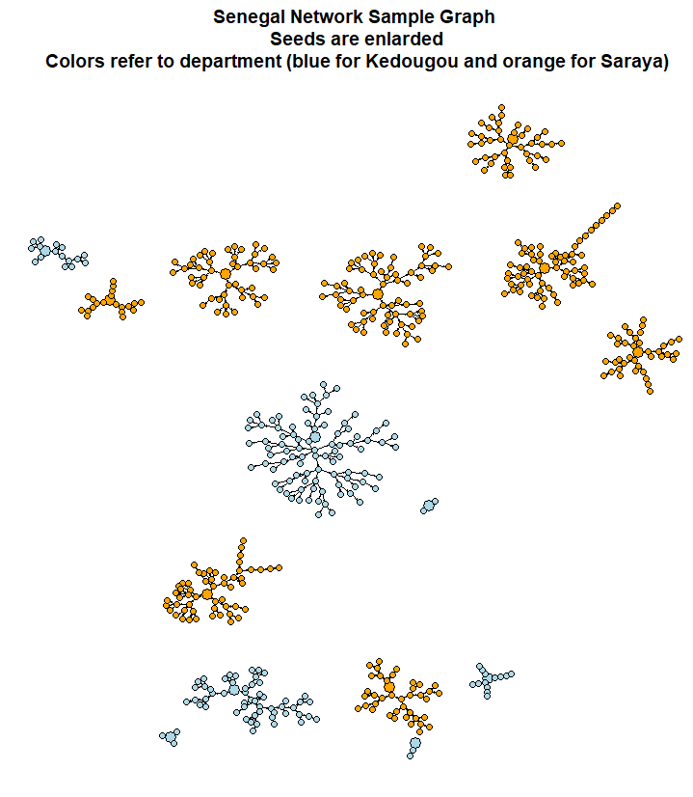
Data Collection
Quantitative study employed Respondent Driven Sampling (RDS) method
  A total of 561 women aged 18-30 years who were engaged in commercial sex were interviewed, with 375 in Saraya and 186 in Kédougou
  15 seeds, of which 7 were from Kédougou and 8 were from Saraya
  12 waves of data collection
  546 links
  Size of the RDS trees range from 3-9
12
Notes:
The RDS design commenced with the selection of 15 seeds, of which 7 were from the department of Kédougou and 8 were from the department of Saraya. Each seed was given three coupons to recruit commercial sex workers in their personal social network. The number of coupons was gradually reduced and ceased when the sample size was approaching the target final sample size; note that a traditional RDS setup does not typically conform with such an adaptive approach and this further motivates the need for researching innovative weighting strategies. The final sample size was 561, of which 186 were observed from Kédougou and 375 from Saraya. Figure 1 gives a visual illustration of the sampled network observed through the RDS peer-recruitment strategy and was generated with the aid of the ‘igraph’ package (Csardi and Nepusz 2006). A total of 546 links were observed. The majority of the sample was selected at waves 2-6. The size of the RDS trees range from 3 to 91.

Slide 13
Data Challenges
Issues and challenges were related to:
  No “cross-over” in links and coupon redemptions between departments, which requires independent analyses applied to each department
  Small sample sizes resulted in issues with convergence of estimators
This motivates research for different prevalence estimation method
Notes:
In the empirical/real-world setting, it is often the case that some of these assumptions are violated and hence new and innovative estimation procedures are needed. For example, for more hidden/isolated populations, rarely would it be the case that any of the aforementioned assumptions hold since: 1) the population is likely to be comprised of several/many disconnected components and modeling data collection with the aid of Markov chain theory (as required for RDS estimation) may not be applicable, whereas the NE4NS procedure is design-based and free of such requirements; 2) respondents would be more likely to recruit those in their personal network to which they have easier access, and the new NE4NS method accounts for this in the subsampling/resampling procedure used to approximate the sample weights as it uses a resampling design similar to that used to select the full sample and resamples around the observed sample networks; and 3) self-reported network sizes are often used for RDS weighting but are prone to recall error, whereas the NE4NS method only utilizes the sample network data observed through peer recruitment for approximating the sample weights.

Slide 14
New Method: New Estimates for Network Sampling (NE4NS)
The new procedure, abbreviated as NE4NS, works by iteratively subsampling from the observed sampled network through a design similar to that used to select the full sample in order to approximate the sampling weights.
The approach only uses the sample network information to approximate the sample weights, and has been found to give estimates superior to those based on traditional RDS weighting schemes (Thompson 2020).
Notes:
In this paper, we utilize data from an RDS study of sex-trafficking victims in two gold-mining regions of Senegal to explore and compare estimates based on the traditional Volz-Heckathorn (2008) weighting scheme, arguably one of the most popular RDS-based weighting schemes, along with those based on a newly introduced design-based procedure by Thompson (2020) that is free of typical RDS assumptions.
The new procedure, abbreviated as NE4NS and whose name is taken to reflect the title of the corresponding paper (i.e., “New Estimates for Network Sampling”), works by iteratively subsampling from the observed sampled network through a design similar to that used to select the full sample in order to approximate the sampling weights. The approach only uses the sample network information to approximate the sample weights, and has been found to give estimates superior to those based on traditional RDS weighting schemes (Thompson 2020).

Slide 15
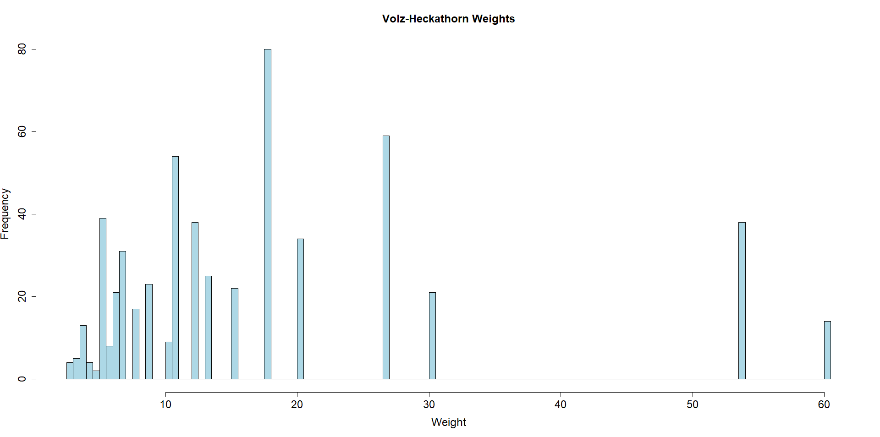
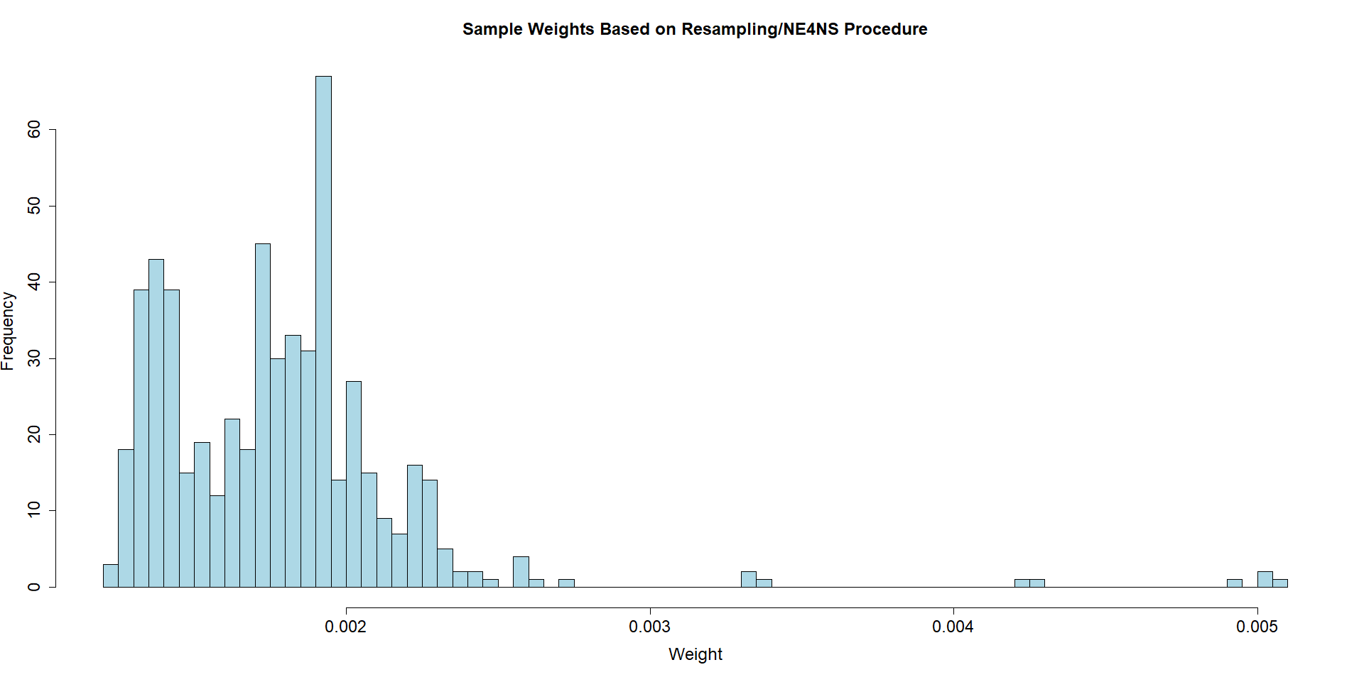
Sample Weighting
  Resampling-based/NE4NS weights based on the procedure delineated in Thompson (2020). The sampling weights are scaled to sum to one
  Histogram of Volz-Heckathorn sample weights after rescaling the edited self-reported network sizes
Notes:
Two sets of sample weights were explored for estimation purposes. The first was based on the Volz-Heckathorn (VH) weighting scheme (Volz and Heckathorn 2008), which is one of the most popular RDS weighting schemes. The second was based on a new and novel resampling procedure delineated in Thompson (2020). As the samples were selected independently and there was a structural reason for not seeing recruitment across the departments of Kédougou and Saraya, namely due to defining personal networks in terms of those who are sex-workers residing/working in the same department as the respondent, the samples were weighted independently and then combined after rescaling the weights to be proportional to the size of the sample. We qualify this choice based on the observation that there was no (disaggregated) prior information on the size of the study population, nor was there a reliable estimate produced for the study population size(s), and hence a natural choice is for each sample to contribute to aggregate estimation with a quantity proportional to its sample size. However, we explore disaggregated estimates by department.
The Volz-Heckathorn weighting scheme approximates the sample weights as being proportional to the inverse of the self-reported network size. To account for the size of the two samples, this was most easily done by rescaling the inverse of the self-reported network sizes to sum to the corresponding proportion of the prechosen study population size of 10,000 for RDS weighting; for Kédougou, this value equated to 186/561 = 33.16% (i.e., 3316) and for Saraya, this value equated to 375/561=66.84% (i.e., 6684). The histogram in Figure 3 presents the distribution of the Volz-Heckathorn sample weights, which sum to 10,000.
The second weighting scheme was based on the procedure outlined in Thompson (2020). The corresponding estimation procedure is design-based and therefore is not based on any model for the study population network or RDS assumptions for estimation. The procedure is a computationally intensive one that iteratively resamples from the sampled network with a design similar to the one used to select the full sample in the empirical setting. Hence, only the sample network data is used for approximating the sampling weights. The inverse of the frequency at which an individual is selected for the subsamples is used to approximate their sample weight. The idea is to approximate the full sample selection probabilities as accurately as possible with the resample/subsample inclusion probabilities through a resampling design that mimics the primary features of that used to select the full network sample, namely through the network sampling design, reseeding and rebranching, and making selections without replacement.
The resampling procedure does not require a study population size estimate since the generalized unequal probability estimator is used for estimation. Simulation studies based on applying RDS designs to a publicly available empirical drug-using population data set have demonstrated that this procedure gives superior estimates to those based on traditional RDS estimation procedures (Thompson 2020).
The resampling procedure was based on an exhaustive number of iterations where the size of the initial resample was 3% of the final targeted resample/subsample size of 100 for Kédougou and 200 for Saraya; the choice of the resampling procedure parameters was taken to reflect the relative initial sample size and those based on the simulation studies presented in Thompson (2020). The approximated resampling weights were rescaled to a value proportional to the sample size for each department. Figure 4 presents a histogram of the resulting resampling-based/NE4NS weights, which for presentation purposes sum to unity; recall that the generalized unequal probability estimator is used for estimation and therefore only the sampling weights up to a proportional constant are required.

Slide 16
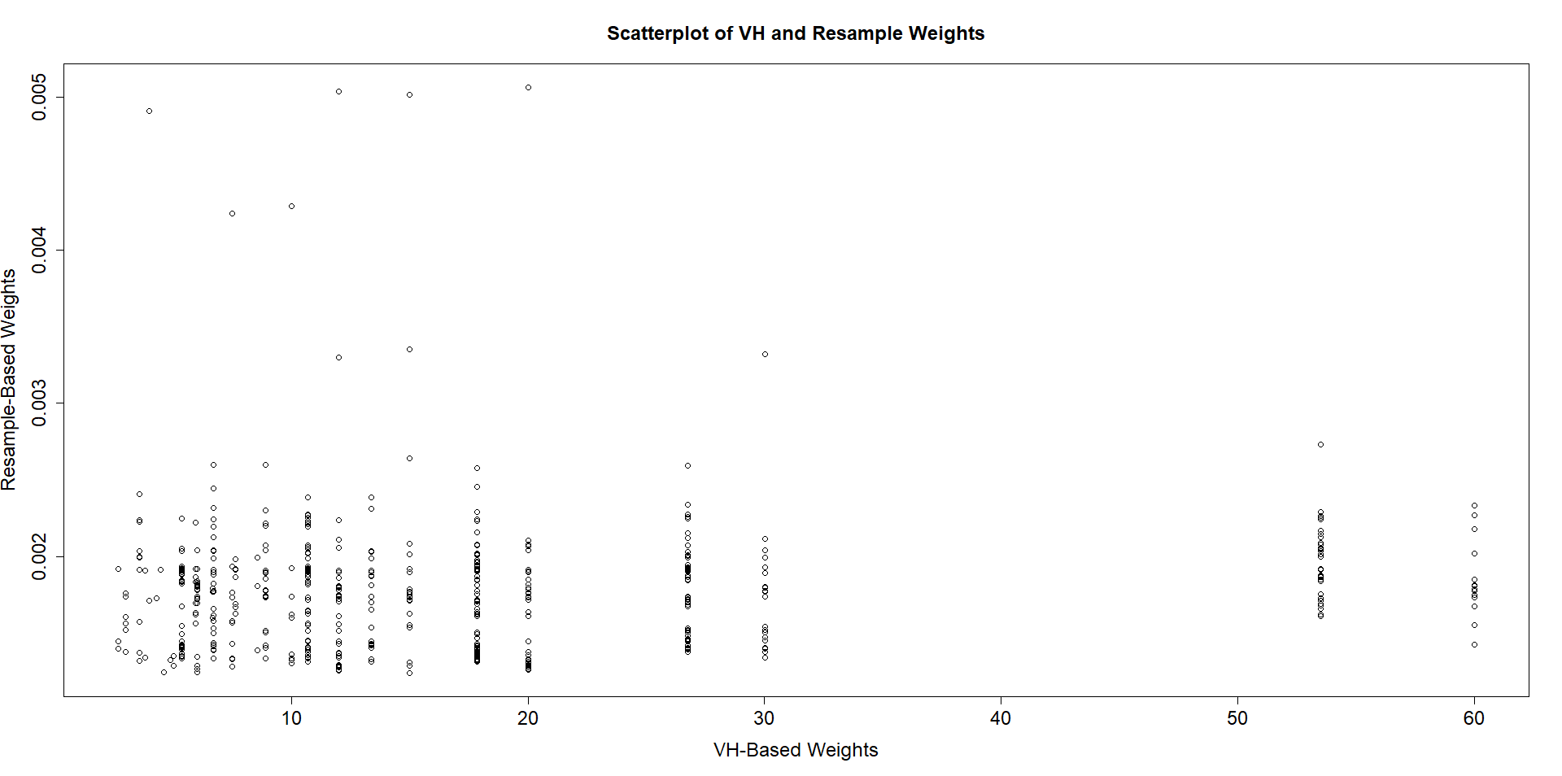
Sample Weighting
  Scatterplot of Volz-Heckathorn and resampling-based NE4NS weights
Notes:
Scatterplot of Volz-Heckathorn- and resampling-based/NE4NS weights

Slide 17
Prevalence Estimates
  Prevalence estimates by weighting strategy for the full study region and disaggregated by department. Left: Sex-trafficking (ST) indicator. Right: Personal network (NET) size
Strategy |  | ST Point Estimate | ST Standard Error | ST Confidence Interval |  | NET Point Estimate | NET Standard Error | NET Confidence Interval
RDS |  | 0.1566 | 0.019 | (0.1193; 0.1939) |  | 3.123 | 0.229 | (2.674; 3.572)
NE4NS |  | 0.1744 | 0.016 | (0.1431; 0.2060) |  | 5.134 | 0.163 | (4.816; 5.453)
RDS
Kédougou |  | 0.2563 | 0.0426 | (0.1729; 0.3397) |  | 3.367 | 0.468 | (2.450; 4.284)
Saraya |  | 0.1071 | 0.0207 | (0.0665; 0.1478) |  | 3.003 | 0.259 | (2.495; 3.510)
NE4NS
Kédougou |  | 0.2829 | 0.0336 | (0.2171; 0.3487) |  | 5.414 | 0.301 | (4.823; 6.004)
Saraya |  | 0.1206 | 0.0168 | (0.0877; 0.1535) |  | 4.996 | 0.191 | (4.621; 5.370)
Notes:
Accurate estimates for the size and distribution of the personal networks of the individuals comprising the study population can greatly assist with informing future studies based on network sampling designs and strategically implementing intervention programs. The new weighting scheme can provide highly efficient estimates for such link-related variables since they are oftentimes highly correlated with the inclusion probabilities (Thompson 2020). The two weighting strategies are used to obtain point estimates, standard errors, and 95% confidence intervals for the prevalence of sex-trafficking and personal network size for the full study region and disaggregated by department, as presented in Table 1; disaggregated estimates are provided since they are in large disagreement across the two departments, and hence aggregate estimates may lead to misleading conclusions. The VH and NE4NS estimates of sex-trafficking indicator and personal network size are respectively within 10% - 13% and 60%-66% of each other in relative terms, which, especially in the latter case, may be considered a sizable difference from a statistical viewpoint. We note that the results presented in Thompson (2020) demonstrate that the resampling procedure’s improvement over existing methods comes largely from the reduction in the bias of the estimates. The sample coefficient of variation of the estimates reinforces the notion that the resampling procedure gives a more efficient estimate. Recall that the VH-estimation procedure requires an estimate of the population size, where 10,000 was originally used, and the standard errors are a function of this estimate. It is not until a population size estimate for VH weight calculation of 1200-1500 for sex trafficking estimation and 650-700 for personal network size estimation is used that the RDS estimates have a sample coefficient of variation on par with those based on the resampling procedure.

Slide 18
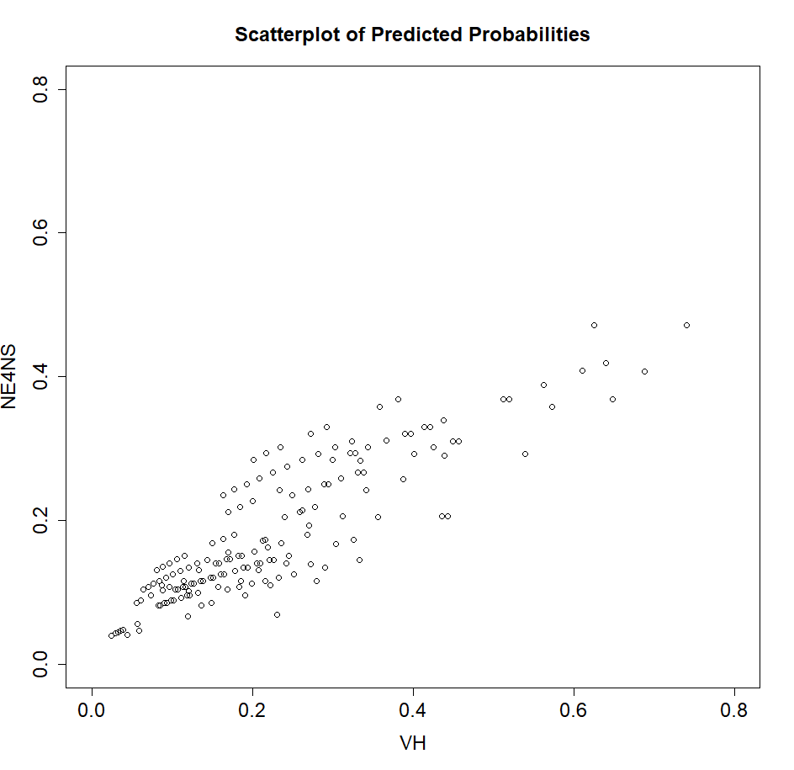
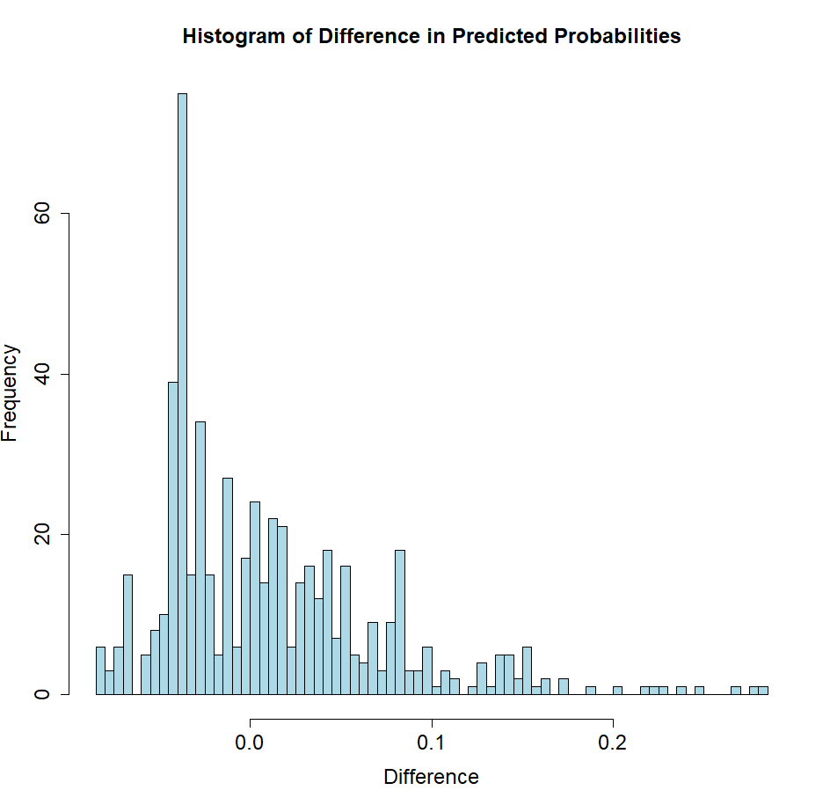
Prevalence Estimates
  Scatterplot and difference of predicted probabilities of respondents based on stepwise AIC model-selection procedure applied to data set based on VH- and NE4NS-based weights
Notes:
Exploratory logistic regression analyses were conducted in which the sex-trafficking indicator was taken as the dependent variable and regressed against key demographics and personal network size through a main effects model based on the two sets of sample weights. The analysis was based on a quasibinomial approach using the svyglm function in the ‘survey’ package (Lumley 2020, 2004), where the survey design objects were based on the respective weights and taken to be independent sampling designs with replacement. The following set of independent/explanatory variables were used in the main effects model: department, age, current school status, religion, current living quarters, number of children, place of origin, marital status, ethnicity, and primary language. Applying a stepwise AIC model-selection procedure (Venables and Ripley 2002) to the data set based on the VH weights lead to the retention of the department, current living quarters, current school status, primary language, and network size variables for the model. In contrast, for the data set based on the NE4NS weights this only led to the retention of the department, current living quarters, and network size variables for the model.
Figure 7 presents a scatterplot of the predicted probabilities based on the two resulting models and corresponding weights along with a histogram of the signed differences. Although a linear trend is present, the plot and histogram show a great deal of disagreement in the predicted probabilities in both the positive and negative directions. This is especially the case for the domain of individuals with a larger self-reported network size and those who have a higher chance of being sex-trafficking victims, as they tend to have the greatest positive difference in the two predicted probabilities. Hence, the choice of which weighting procedure to use in the estimation procedure must be done with care as the two approaches could lead to discrepant conclusions used to guide intervention strategies.

Slide 19
Conclusion
We have applied a traditional RDS weighting scheme and an original, empirical application of the Thompson (2020) weighting scheme to the RDS data set and compared the results based on estimates
As the new weighting scheme is free of model assumptions, it was found to be a robust alternative for when RDS network assumptions are not met, and we encourage future studies to explore its use.
Our findings suggest that the new weighting scheme has the potential to draw drastically different conclusions about the study population relative to other RDS weighting schemes, especially when violations of RDS assumptions are suspected.
Notes:
In this paper, we have detailed the RDS methodology for a study on sex-workers in two departments of the Kédougou region of Senegal. We have applied a traditional RDS weighting scheme and an original, empirical application of the Thompson (2020) weighting scheme to the RDS data set and compared the results based on estimates and logistic regression analyses of sex-trafficking and personal network size characteristics. As the new weighting scheme is free of model assumptions, it was found to be a robust alternative for when RDS network assumptions are not met, and we encourage future studies to explore its use. Our findings suggest that the new weighting scheme has the potential to draw drastically different conclusions about the study population relative to other RDS weighting schemes, especially when violations of RDS assumptions are suspected.
RDS with traditional RDS-type weighting schemes have been used in recent studies where violations of RDS assumptions may be suspected, such as that based on a sex-trafficking population in Muzzafarpur, India (Vincent et al. 2021) and a child-laborer population in Bihar, India (Zhang et al. 2019). In both studies, a variant of RDS was applied and which commenced with the selection of a generously-sized seed sample. The design then allowed for two waves of data collection to obtain the final sample. In the former, they applied the Gile successive sampling weighting scheme (Gile 2011) to approximate the sampling weights. In the latter, sample weighting commenced with assigning weights based on the Volz-Heckathorn weighting scheme and then the RDS sample was combined with a probability sample, based on a conventional design, and calibrating to population totals. In both cases, i) the design was restricted to only two waves but such RDS weighting schemes typically require at least five or six waves in order to reach sample equilibrium, and ii) the sample size was small and convergence/bottleneck checks may not be reliable for assessing if RDS assumptions have been met. Hence, for such cases, the NE4NS weighting scheme would serve as an appropriate and robust alternative for basing estimation upon.

Slide 20





Acknowledgements
Notes:
We would like to thank our funder US department of state; teammates Prof. Alex Balch and his research team based in University of Liverpool.
We also acknowledge the partnership with Free the Slaves who supported the Prevention and Protection of the programming;
Programming partner UNODC whose focal area was prosecution.
We also work with Research and Evaluation partner, Population Council.

Slide 21


Contact Us
Dr. Hui Yi*, Assistant Research Scientist and Data Scientist – huiyi@uga.edu
Dr. Kyle Vincent, Senior Statistical Consultant - kyle.shane.vincent@gmail.com
Dr. Jody Clay-Warner, Meigs Professor of Sociology, jclayw@uga.edu
Dr. David Okech, Georgia Athletics Association Endower Professor of Human Trafficking Implementation Research, Director of CenHTRO, Director of Prevalence Reduction Innovation Forum (PRIF) – dokech@uga.edu
Nnenne Onyioha-Clayton, Program Manager for Senegal Program – no.clayton@uga.edu
Dr. Anne Waswa, Monitoring, Evaluation, and Learning Coordinator – anne.waswa@uga.edu

Slide 22

Thank you
Q & A

